Slide 1
Lecture 3 Retrieval Models Part 2
This Part Composed of Contents Come from Courseware of Below Professors:
James Allan, University of Massachusetts Amherst
Gerald Benoit, Simmons College
Pandu Nayak and Prabhakar Raghavan, Stanford University
Edited by: Qingcai Chen, HIT Shenzhen Graduate School

Slide 2
Models we’ll consider
Boolean (exact match)
Statistical language models
Vector space
Latent Semantic Indexing
Inference network (推理网络)
Classic probabilistic approaches
this lecture
Left to latter lectures

Slide 3
Document Representation in Boolean Model
Sec. 1.1
What’s the main issue of this representation?
1 if play contains word, 0 otherwise
Brutus AND Caesar BUT NOT Calpurnia

Slide 4
Questions before the VSM
How to measure the distance of two complicate objects in machine learning?
How to mathematically measure the relevance of two objects?
Why we think that Boolean model is not a good model for text retrieval?
Notes:
Review the matrix for boolean model.

Slide 5
Vector Space Model
Variations (不同形式):
Vector space retrieval model (向量空间模型)
Latent Semantic Indexing (潜层语义索引)
Key idea:
Everything (documents, queries, terms) is a vector in a high-dimensional space
Example systems
SMART,
G. Salton and students at Cornell starting in the 60’s
Lucene
popular open source search engine written in Java,
still be a building block of many commercial SEs
Most Web search engines are similar
Notes:
The important of VSM is not just because that it is widely applied, but also because that it did inspired a lot of related methods, and also provided guide for the design of index file.

Slide 6
Vector space issues
How to select basis vectors(基向量) (dimensions)
How to convert objects into vectors
Terms
Documents
Queries
How to select magnitude (幅值) along a dimension
How to compare objects in vector space
Comparing queries to documents

Slide 7
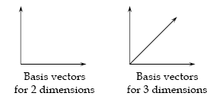
Vector Space and Basis Vectors
Formally, a vector space is defined by a set of linearly independent (线性独立) basis vectors. (Why?)
Basis vectors:
correspond to the dimensions or directions in the vector space;
determine what can be described in the vector space; and
must be orthogonal (正交), or linearly independent, i.e. a value along one dimension implies nothing about a value along another.

Slide 8
Selection of Basic Vector
What should be the basis vectors for IR? (feature selection problem)
“Core” concepts of discourse?*
orthogonal (by definition)
a relatively static vector space
probably not too many dimensions
But… difficult to determine (Philosophy? Cognitive science?)
Use terms that appear?
easy to determine
But…
not at all orthogonal (but it may not matter much)
a constantly growing vector space (new vocabulary)
huge number of dimensions
Notes:
*A lot of researchers have worked on it, and some famous projects such as WordNet, HowNet, HNC etc. have also helped us in NLP.

Slide 9
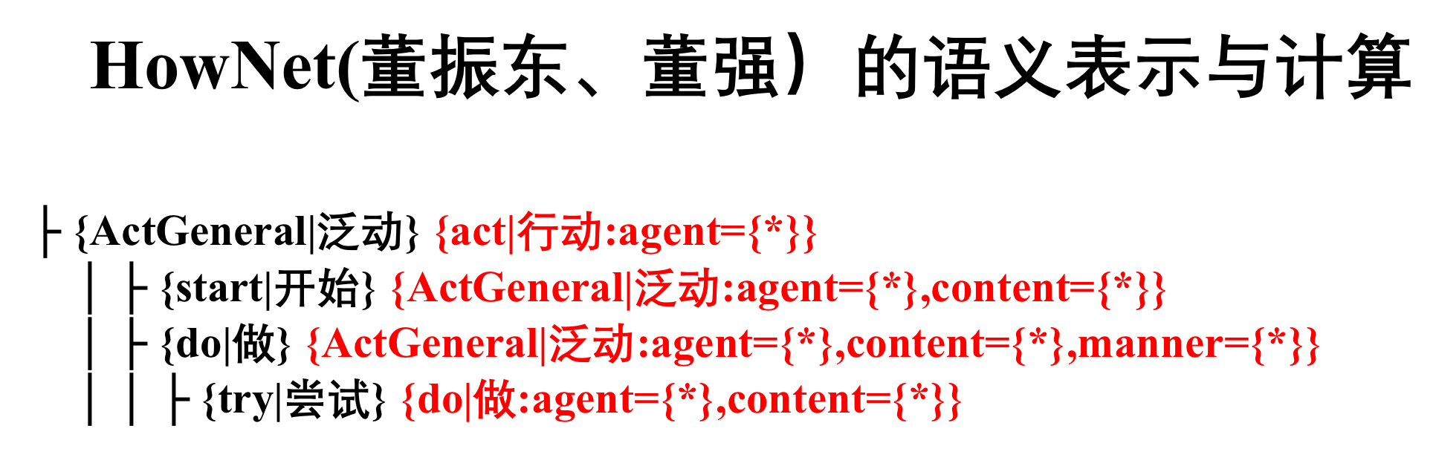
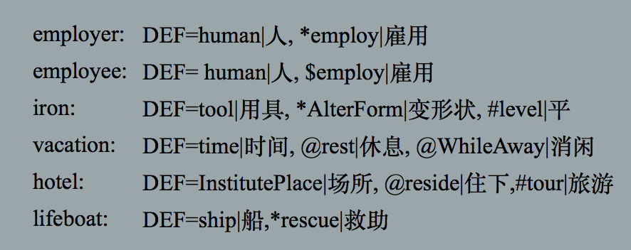
Selection of Basic Vector
What should be the basis vectors for IR? (feature selection problem)
“Core” concepts of discourse?*
orthogonal (by definition)
a relatively static vector space
probably not too many dimensions
But… difficult to determine (Philosophy? Cognitive science?)
Use terms that appear?
easy to determine
But…
not at all orthogonal (but it may not matter much)
a constantly growing vector space (new vocabulary)
huge number of dimensions
Notes:
*A lot of researchers have worked on it, and some famous projects such as WordNet, HowNet, HNC etc. have also helped us in NLP.

Slide 10
Selection of Basic Vector
What should be the basis vectors for IR? (feature selection problem)
“Core” concepts of discourse?*
orthogonal (by definition)
a relatively static vector space
probably not too many dimensions
But… difficult to determine (Philosophy? Cognitive science?)
Use terms that appear?
easy to determine
But…
not at all orthogonal (but it may not matter much)
a constantly growing vector space (new vocabulary)
huge number of dimensions
Notes:
*A lot of researchers have worked on it, and some famous projects such as WordNet, HowNet, HNC etc. have also helped us in NLP.

Slide 11
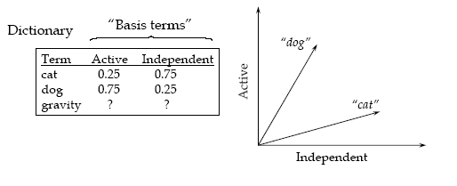
Mapping to basis vectors: terms
How do basis vectors relate to terms?
Each term is represented as a linear combination of basis vectors.
cat = 0.25 Active + 0.75 Independent (or cat = 0.25 x + 0.75 y)
dog = 0.75 x + 0.25 y

Slide 12
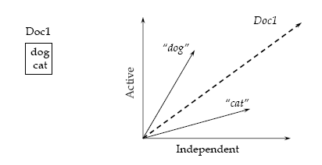
Mapping to basis vectors: documents
How are documents represented?
A document is represented as the sum of its term vectors.

Slide 13
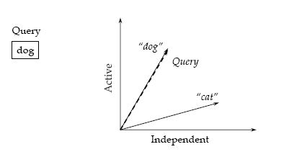
Mapping to basis vectors: queries
How are queries represented?
Same way that documents are

Slide 14
Vector Coefficients
The coefficients (vector lengths, term weights) represent term presence, importance, or “aboutness”
Magnitude along each dimension
Model gives no guidance on how to set term weights
Some common choices:
Binary: 1 = term is present, 0 = term not present in document
tf: The frequency of the term in the document
tf idf (inverse document frequency) indicates the discriminatory power (辨识能力) of the term (why?)
Tf·idf is far from the most common
Numerous variations…
Notes:
Why idf?

Slide 15
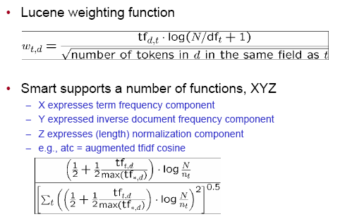
Term weighting functions (e.g.)

Slide 16
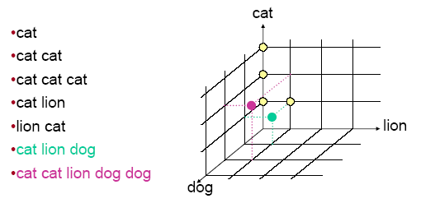
Example: 3-word vocabulary (tf weights)

Slide 17
Similarity
Problem: Given two text documents, how similar are they?
[Methods that measure similarity do not assume exact matches.]
Example
Here are three documents. How similar are they?
d₁ ant ant bee
d₂ dog bee dog hog dog ant dog
d₃ cat gnu dog eel fox
Documents can be any length from one word to thousands.
A query is a special type of document.

Slide 18
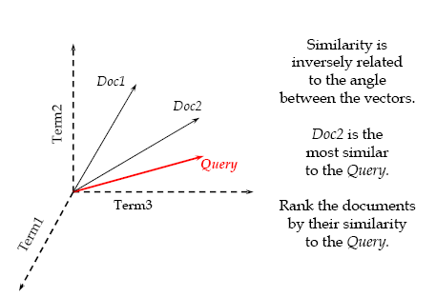
Vector Space Similarity

Slide 19

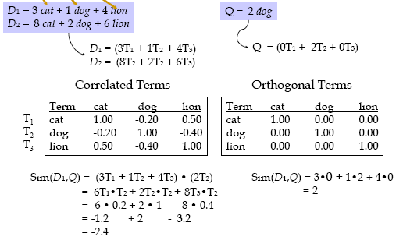
Vector Space Similarity: Weighted Features Example
词语的One-hot表示？

Slide 20
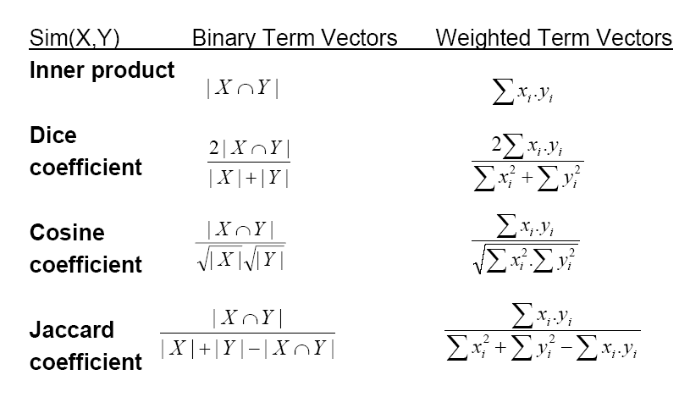
Vector Space Similarity: Common Measures

Slide 21
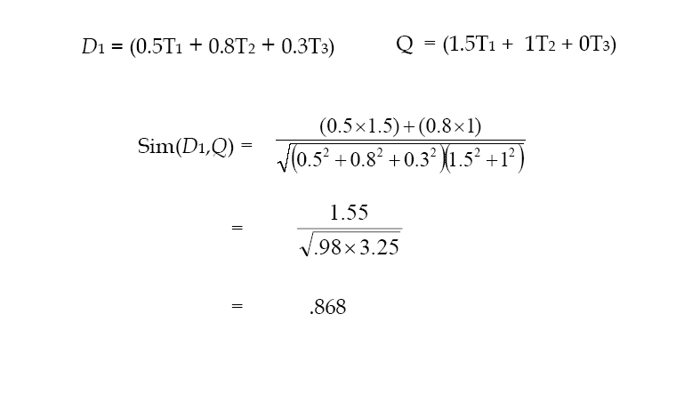
Vector Space Similarity: Cosine Coefficient (Correlation) Example
Notes:
Whot’s the problem of this computation?

Slide 22
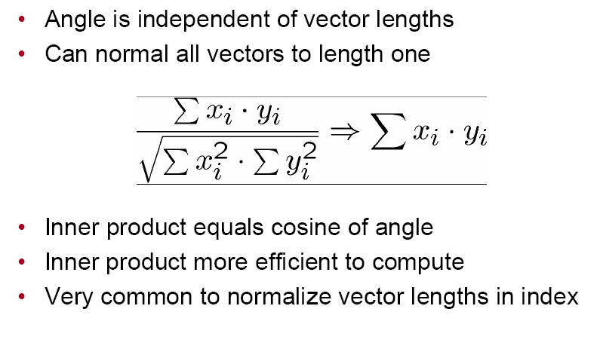
Cosine and vector lengths

Slide 23
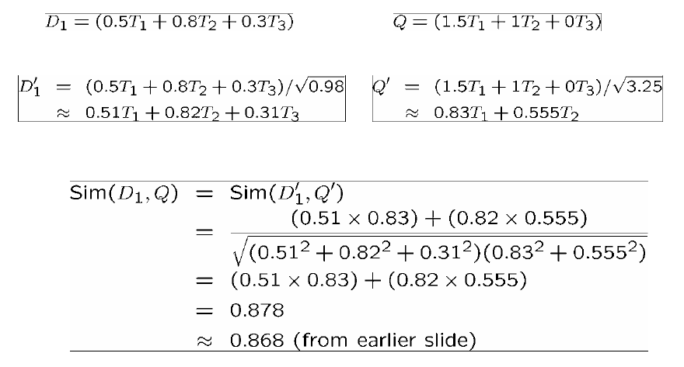
Example again, normalized

Slide 24
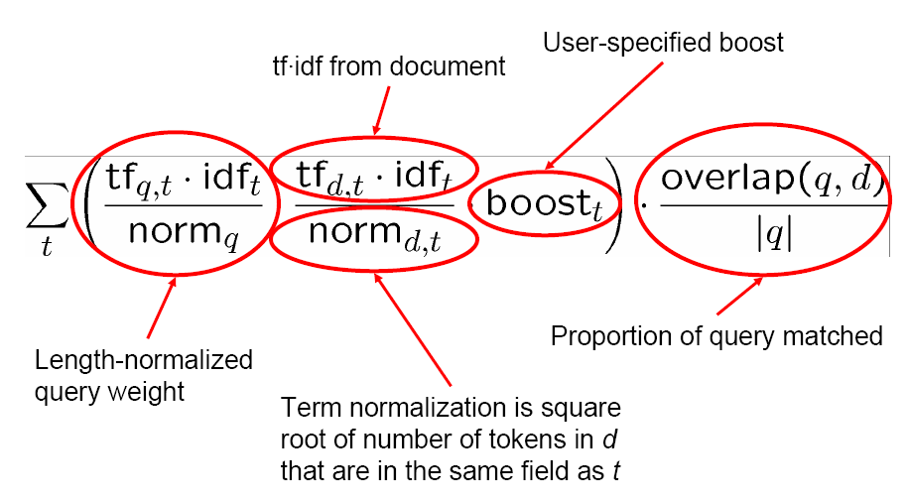
Other comparisons: Lucene

Slide 25
Summary: Vector Similarity Computation with Weights
Documents in a collection are assigned terms from a set of n terms
The term vector space W is defined as:
if term k does not occur in document d_{i}, w_{ik} = 0
if term k occurs in document d_{i}, w_{ik} is greater than zero
(w_{ik} is called the weight of term k in document d_{i})
Similarity between d_{i} and d_{j} is defined as:
Σ w_{ik}w_{jk}
|d_{i}| |d_{j}|
Where d_{i} and d_{j} are the corresponding weighted term vectors
_{n}
cos(d_{i}, d_{j}) =
^{k=1}

Slide 26
Simple Uses of Vector Similarity in Information Retrieval
Threshold
For query q, retrieve all documents with similarity above a threshold, e.g., similarity > 0.50.
Ranking
For query q, return the n most similar documents ranked in order of similarity.
[This is the standard practice.]

Slide 27
Simple Example of Ranking (Weighting by Term Frequency)
query
q ant dog
document text terms
d₁ ant ant bee ant bee
d₂ dog bee dog hog dog ant dog ant bee dog hog
d₃ cat gnu dog eel fox cat dog eel fox gnu
Now compute the similarities of these documents with q?
ant bee cat dog eel fox gnu hog length
q 1 1 √2
d₁ 2 1 √5
d₂ 1 1 4 1 √19
d₃ 1 1 1 1 1 √5

Slide 28
Calculate Ranking
Similarity of query to documents in example:
d₁ d₂ d₃
q 2/√10 5/√38 1/√10
0.63 0.81 0.32
If the query q is searched against this document set, the ranked results are:
d₂, d₁, d₃

Slide 29
Cosine similarity amongst 3 documents
Sec. 6.3
How similar are
the novels
SaS: Sense and
Sensibility
PaP: Pride and
Prejudice, and
WH: Wuthering
Heights?
term | SaS | PaP | WH
affection | 115 | 58 | 20
jealous | 10 | 7 | 11
gossip | 2 | 0 | 6
wuthering | 0 | 0 | 38
Term frequencies (counts)

Slide 30
3 documents example contd.
Sec. 6.3
Log frequency weighting
After length normalization
term | SaS | PaP | WH
affection | 3.06 | 2.76 | 2.30
jealous | 2.00 | 1.85 | 2.04
gossip | 1.30 | 0 | 1.78
wuthering | 0 | 0 | 2.58
term | SaS | PaP | WH
affection | 0.789 | 0.832 | 0.524
jealous | 0.515 | 0.555 | 0.465
gossip | 0.335 | 0 | 0.405
wuthering | 0 | 0 | 0.588
cos(SaS,PaP) ≈
0.789 × 0.832 + 0.515 × 0.555 + 0.335 × 0.0 + 0.0 × 0.0
≈ 0.94
cos(SaS,WH) ≈ 0.79
cos(PaP,WH) ≈ 0.69

Slide 31
Vector Space Revision
x = (x₁, x₂, x₃, ..., x_{n}) is a vector in an n-dimensional vector space
Length of x is given by (extension of Pythagoras's theorem)
|x|² = x₁² + x₂² + x₃² + ... + x_{n}²
If x₁ and x₂ are vectors:
Inner product (or dot product) is given by
x₁.x₂ = x₁₁x₂₁ + x₁₂x₂₂ + x₁₃x₂₃ + ... + x_{1n}x_{2n}
Cosine of the angle between the vectors x₁ and x_{2:}
cos (θ) =
x₁.x₂ |x₁| |x₂|

Slide 32
Standard vector space, summary
Very simple
Map everything to a vector
Compare using angle between vectors
Challenge is mostly finding good weighting scheme
Variants on tf·idf are most common
Model provides no guidance
Another challenge is comparison function
Cosine comparison is most common
Generic inner product (without unit vectors) also occurs
Too many dimensions for storage and computing
Redundant basis vectors caused by non-independent terms

Slide 33
Models we’ll consider
Boolean (exact match)
Statistical language models
Vector space
Latent Semantic Indexing

Slide 34
Latent Semantic Indexing (LSI)
One variant of the vector space model
Use Singular Value Decomposition to identify uncorrelated, significant basis vectors or factors
Rather than non-independent terms
Replace original words with a subset of the new factors (say 100) in both documents and queries
Compute similarities in this new space
Computationally expensive, uncertain effectiveness

Slide 35
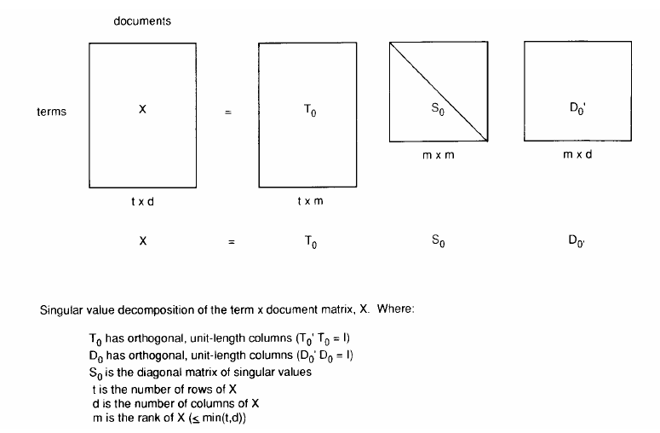
LSI
Notes:
Here T₀ respects to the orthonormal matrix of XX^{T}, while D₀ respects to the orthonormal matrix of X^{T}X. That’s why T₀ is called term matrix, because it can be treated as the term similarity matrix. And D₀ is called document matrix since it can be thought as document similarity matrix.

Slide 36
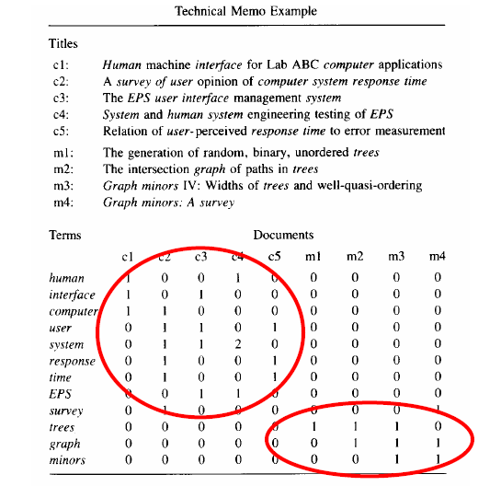
LSI: example
Notes:
Document collections m and c have nearly no common words, but we do know that these documents get some implied connections (in semantic sense)

Slide 37
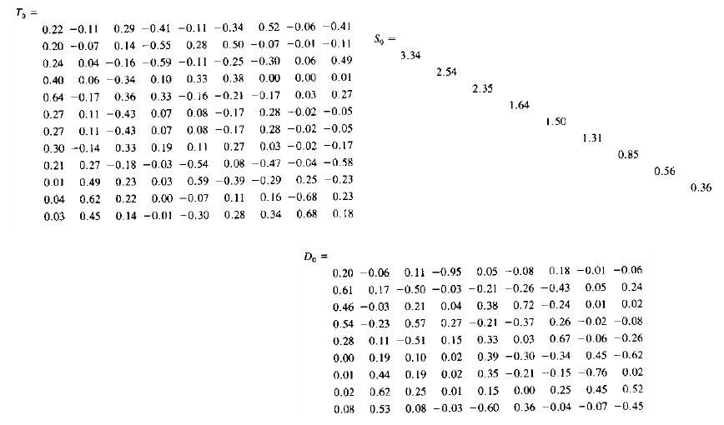
LSI: example (2)
Decreasing order

Slide 38
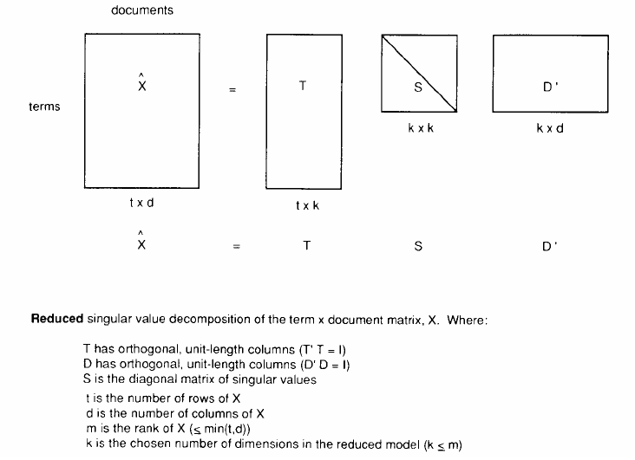
LSI

Slide 39
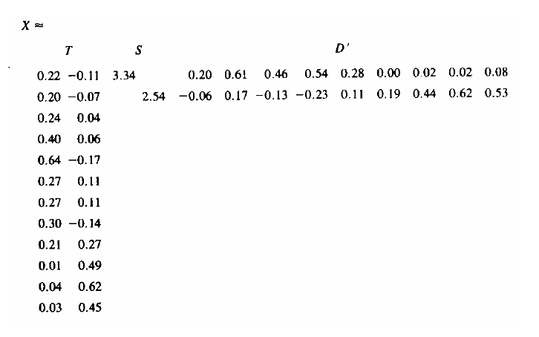
LSI: example for ”k=2”

Slide 40
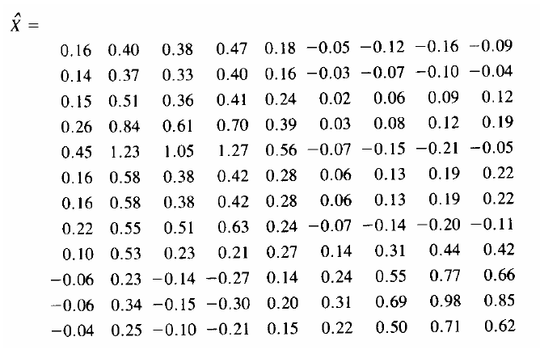
LSI: example (3)

Slide 41
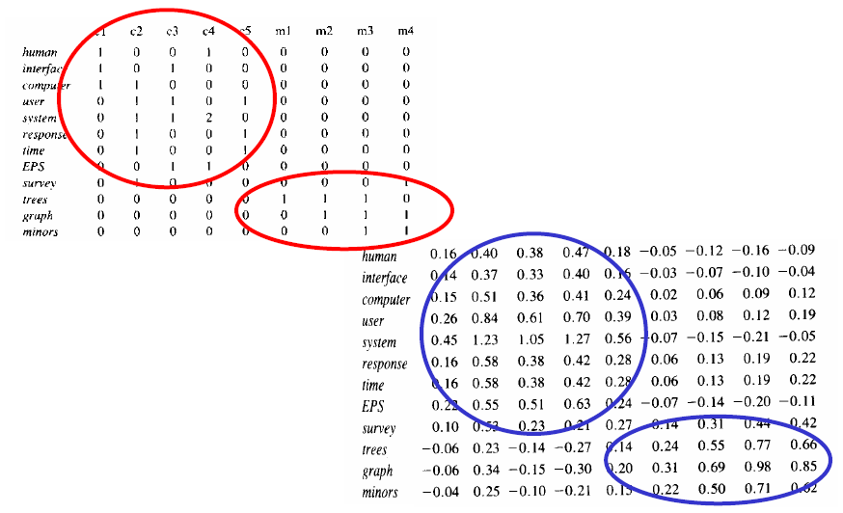
Comparing original and LSI

Slide 42
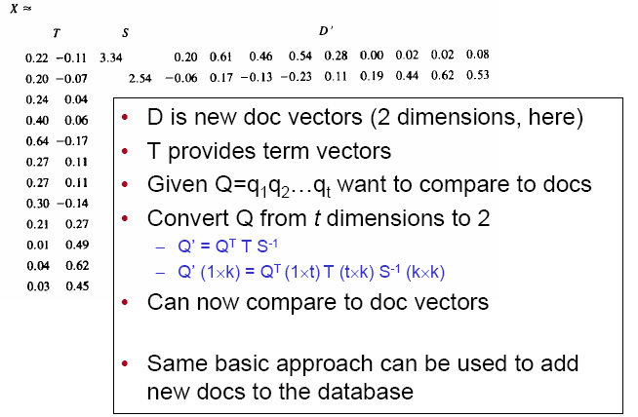
Using LSI

Slide 43
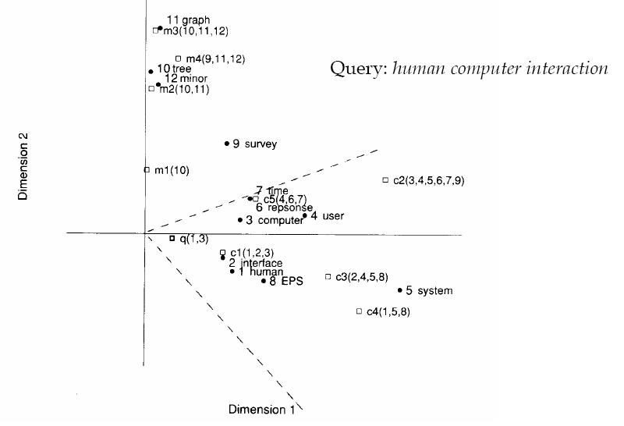
LSI
Notes:
The hits for the query are located in the zone limited by dot-lines.

Slide 44
Is LSI any good?
Decomposes language into “basis vectors”
In a sense, is looking for core concepts
In theory, this means that system will retrieve documents using synonyms of your query words
The “magic” that appeals to people
From a demo at http://lsi.research.telcordia.com
They hold the patent on LSI
Query “manna” (以色列人漂泊荒野时上帝所赐的食物) on Bible verses (312 dimensions)
#5 – Exodus (出埃及记) 12_20 Ye shall eat nothing leavened; in all your habitations shall ye eat unleavened(未发酵的) bread.
#6 -- Genesis 31_54 Then Jacob offered sacrifice upon the mount, and called his brethren to eat bread: and they did eat bread, and tarried all night in the mount.
Things like this are major claim of LSI techniques

Slide 45
Magic can be confusing
Top 5 hits for query “apple” (312 dimensions)
Song_of_Songs 8_5 Who is this that cometh up from the wilderness, leaning upon her beloved? I raised thee up under the apple tree: there thy mother brought thee forth: there she brought thee forth that bare thee.
Psalms 47_3 He shall subdue the people under us, and the nations under our feet. ????
Song_of_Songs 2_3 As the apple tree among the trees of the wood, so is my beloved among the sons. I sat down under his shadow with great delight, and his fruit was sweet to my taste.
Zecharaiah 3_10 In that day, saith the LORD of hosts, shall ye call every man his neighbour under the vine and under the fig tree(无花果树). Magic?
Ecclesiastes 4_7 Then I returned, and I saw vanity under the sun. ????

Slide 46
Vector Space Retrieval Model: Summary
Standard vector space
Each dimension corresponds to a term in the vocabulary
Vector elements are real-valued, reflecting term importance
Any vector (document, query, ...) can be compared to any other
Cosine correlation is the similarity metric used most often
Latent Semantic Indexing (LSI)
Each dimension corresponds to a “basic concept”
Documents and queries mapped into basic concepts
Same as standard vector space after that
Whether it’s good depends on what you want

Slide 47
Vector Space Model: Disadvantages
Assumed independence relationship among terms
Though this is a very common retrieval model assumption
Lack of justification for some vector operations
e.g. choice of similarity function
e.g., choice of term weights
Barely a retrieval model
Doesn’t explicitly model relevance, a person’s information need, language models, etc.
Assumes a query and a document can be treated the same (symmetric)
Lack of a cognitive (or other) justification

Slide 48
Vector Space Model: Advantages
Simplicity
Ability to incorporate term weights
Any type of term weights can be added
No model that has to justify the use of a weight
Can measure similarities between
documents and queries
documents and documents
queries and queries
sentences and sentences
etc.

Slide 49
Homework 03
Sec. 7.1.2
1.In this homework, you are asked to derive the detail computing process of SVD for a given Term/Document matrix A.
To make your deducing process more clear, using an artificial matrix, e.g. a 3*4 dimension matrix, is strongly suggested, i.e. will get extra points.
2.Read a paper (read some wiki) about PCA (principle component analysis), then answer below question:
What is PCA (principle component analysis)? What is the difference between PCA and SVD?
You should only submit your HANDWRITTEN deducing process. Any form of electronic document (even printed out on paper) will be REJECTED!
Due Date:

Slide 50
Backup

Slide 51
Efficiency of VSM A glance for implementation
Problems: how to implement efficient cosine ranking?
Basic Assumption:
Find out K best documents that match a query rather than rank all documents

Slide 52
Efficient cosine ranking
Sec. 7.1
Find the K docs in the collection “nearest” to the query ⇒ K largest query-doc cosines.
Efficient ranking:
Computing a single cosine efficiently.
Choosing the K largest cosine values efficiently.
Can we do this without computing all N cosines?

Slide 53
Efficient cosine ranking
Sec. 7.1
What we’re doing in effect: solving the K-nearest neighbor problem for a query vector
In general, we do not know how to do this efficiently for high-dimensional spaces
But it is solvable for short queries, and standard indexes support this well, and we just take a glance for some of the solutions since Indexing is still not discussed.

Slide 54
Special case – unweighted queries
Sec. 7.1
No weighting on query terms
Assume each query term occurs only once
Then for ranking, don’t need to normalize query vector
Slight simplification of algorithm

Slide 55
Computing the K largest cosines: selection vs. sorting
Sec. 7.1
Typically we want to retrieve the top K docs (in the cosine ranking for the query)
not to totally order all docs in the collection
Can we pick off docs with K highest cosines?
Let J = number of docs with nonzero cosines
We seek the K best of these J

Slide 56
Use heap for selecting top K
Sec. 7.1
Binary tree in which each node’s value > the values of children
Takes 2J operations to construct (the time complexity for optimized construction of binary heap*), then each of K “winners” read off in 2log J steps.
For J=1M, K=100, this is about 10% of the cost of sorting.
1
* http://en.wikipedia.org/wiki/Binary_heap
.9
.3
.3
.8
.1
.1

Slide 57
Bottlenecks
Sec. 7.1.1
Primary computational bottleneck in scoring: cosine computation
Can we avoid all this computation?
Yes, but may sometimes get it wrong
a doc not in the top K may creep into the list of K output docs
Is this such a bad thing?

Slide 58
Cosine similarity is only a proxy
Sec. 7.1.1
User has a task and a query formulation
Cosine matches docs to query
Thus cosine is anyway a proxy for user happiness
If we get a list of K docs “close” to the top K by cosine measure, should be ok

Slide 59
Generic approach
Sec. 7.1.1
Find a set A of contenders, with K < |A| << N
A does not necessarily contain the top K, but has many docs from among the top K
Return the top K docs in A
Think of A as pruning non-contenders
The same approach is also used for other (non-cosine) scoring functions
Will look at several schemes following this approach

Slide 60
Index elimination
Sec. 7.1.2
Basic algorithm
cosine computation algorithm only considers docs containing at least one query term
Take this further:
Only consider high-idf query terms
Only consider docs containing many query terms

Slide 61
High-idf query terms only
Sec. 7.1.2
For a query such as “catcher in the rye”
Only accumulate scores from catcher and rye
Intuition: in and the contribute little to the scores and so don’t alter rank-ordering much
Benefit:
Postings of low-idf terms have many docs → these (many) docs get eliminated from set A of contenders

Slide 62
Docs containing many query terms
Sec. 7.1.2
Any doc with at least one query term is a candidate for the top K output list
For multi-term queries, only compute scores for docs containing several of the query terms
Say, at least 3 out of 4
Imposes a “soft conjunction” on queries seen on web search engines (early Google)
Easy to implement in postings traversal

Slide 63
3 of 4 query terms
Sec. 7.1.2
Antony
3
4
8
16
32
64
128
Brutus
2
4
8
16
32
64
128
Caesar
1
2
3
5
8
13
21
34
Calpurnia
13
16
32
Scores only computed for docs 8, 16 and 32.

